Slide 1
Halil AKSU
MS: University of Southern California, Operations Research
Predicting the Value of a Used Vehicle
April 16th, 2018

Slide 2
Personel Background:
16 years of experience on management and analysis
Additional background on international relations and public affairs
Valuable experience on logistics and personnel management
BS degree on Industrial Engineering (graduated 3rd out of 242)(3.84)
MS degree on Operations Research (3.79)
MA degree on Leadership and Management (graduated 3rd place)
Numerous presentations before various VIP audience

Slide 3
Predicting the Value of a Used Vehicle
Data Science Career Track Capstone Project, February 05th 2018 Cohort

Slide 4
Who might care?
Problem Introduction
Websites/ Mobile Apps
Individual Buyers
Dealers

Slide 5
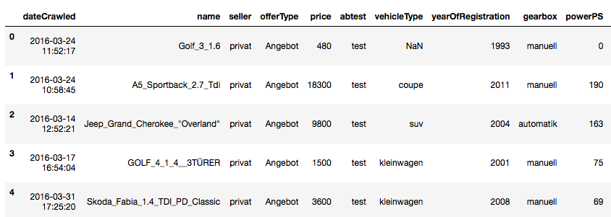
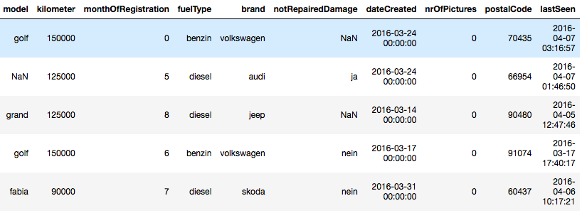
Data Set :
From Kaggle
19 features and 371528 data points/ observations
Target Feature is ‘price’

Slide 6
Data Exploration :
Seller feature: 3 out of 371528 observations are dealer. So this feature can be dropped.
Offer Type feature : 12 out of 371528 observations are Gesuch. So this feature can be dropped.
Number of Pictures feature has all 0 values. So this feature can also be dropped.
PowerPS Feature : 40820 observations are 0. So this needs to be dealt with.
vehicleType has 37869, gearbox has 20209, model has 20484, fuelType has 33386, notRepairedDamage has 72060 NULL values.
13 unique numbers for the 'kilometer' (mileage) exist. So we can keep them all since there is no outlier.
7 features are discrete, numbers, whereas
12 features are object (string, datetime....)
Shape of the data is 371528x20 (‘Age’ feature has been created to better examine the data set.).
"vehicleType, gearbox, model, fuelType, brand, notRepairedDamage" Features have missing values!!!

Slide 7
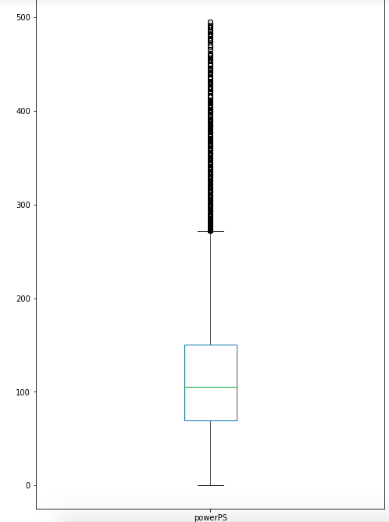
Filtering Parameters:
After examining the samples with horsepower higher than 600 and lower than 5, it is more likely to get rid of these as outliers.

Slide 8
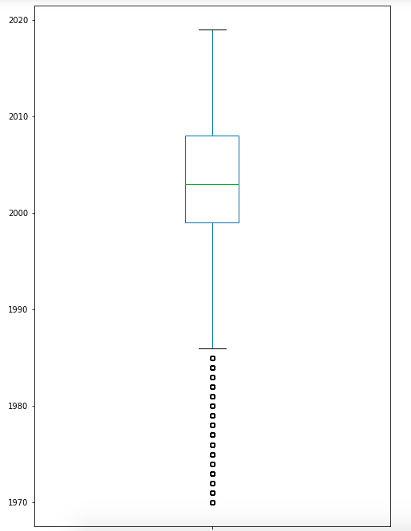
Filtering Parameters:
Since the data was scraped in 2016, samples with a registration date of 2017 and above should be deleted.
The number of cars with a value of above 100.000 is 403. So I am assuming these as outliers. However, despite the fact that the number of cars with a ‘0’ value is 10778, I will keep them since these vehicles could be considered to be given away as a present.
The percentage of samples/observations lost after filtering is % 14.5.

Slide 9
Handling Missing Values:
It may mislead to keep the missing values by replacing with an interpolation for this data set. So considering the richness of the number of samples, I am opting for getting rid of the missing of values.
The percentage of samples/observations lost after deleting missing values is % 30.
The shape of the data set before the data wrangling is 371528x19, and its shape became 250160x16 after.

Slide 10
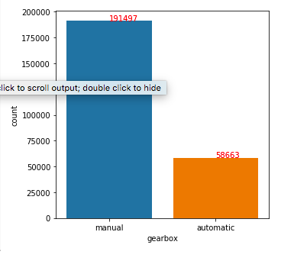
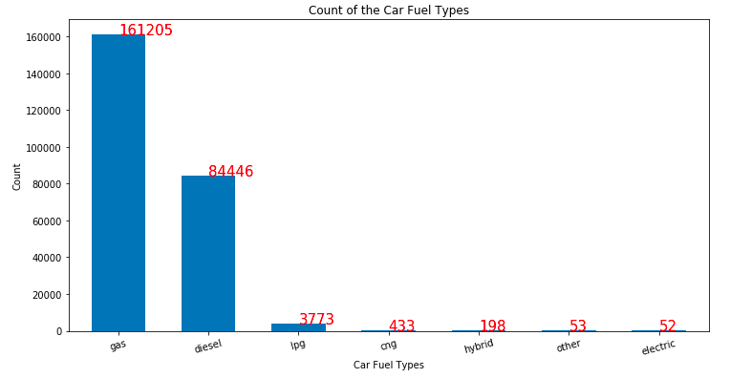
Data Visualization:
Manual vehicles are more common in Europe. (Knowing that the data set comes from a European website)
Number of vehicles operated by gas is 161.205, whereas the number of vehicles operated by diesel fueltype is 84.446. Diesel operated vehicles are very popular in Europe. In addition, liquid petroleum gas (LPG), compressed natural gas(CNG) operated vehicles exist in spite of the of the fact that their number is low.

Slide 11
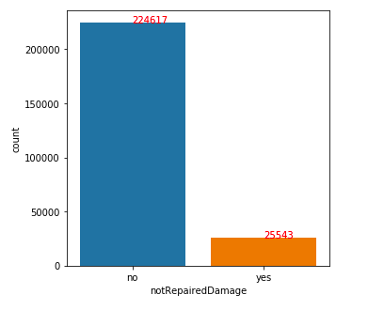
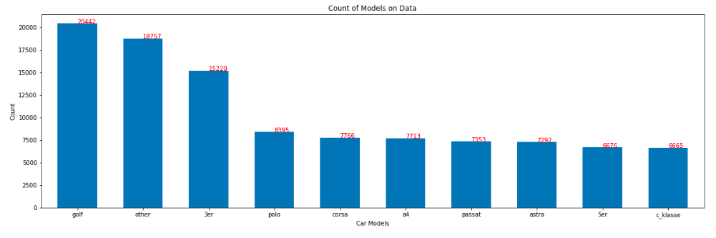
Data Visualization:
Most Vehicles do not have any repair or damage history. This may be misleading, because most pre-owned cars don’t tend to speak out this information once the potential customer engages and indicates interest in the vehicle.
Golf, Polo, Corsa, Passat are the most common models in Europe.

Slide 12
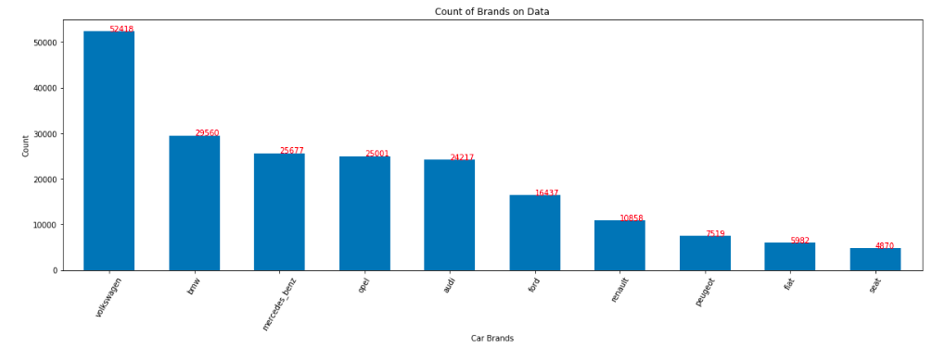
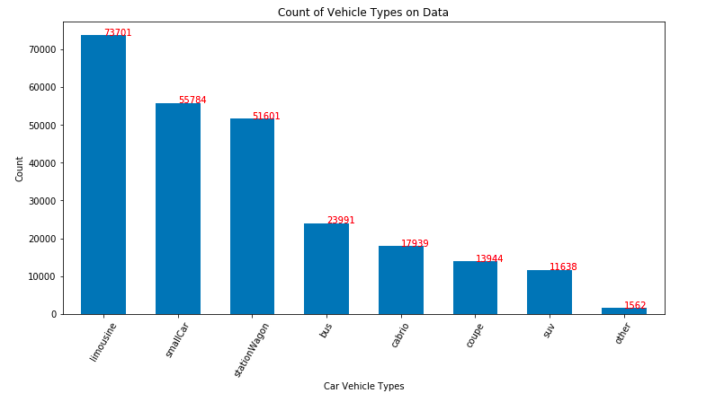
Data Visualization:
VW, BMW, Mercedes Benz, Opel, Audi, Ford keep the leading positions compared to other brands in Europe.
Number of Limousine (Sedan) vehicles is 73701, wheres that of SUVs is 11638.

Slide 13
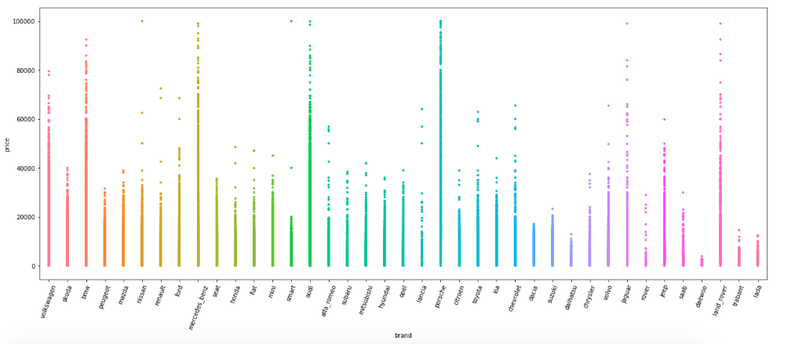
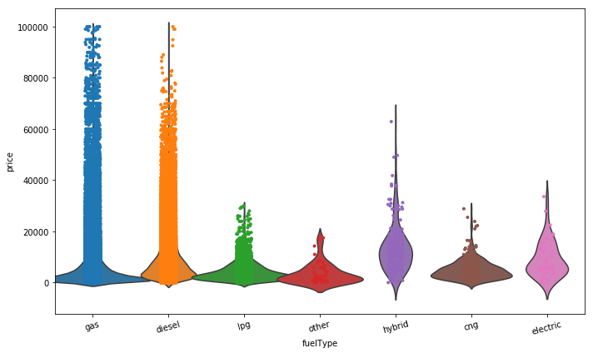
Data Visualization:
It is easy to examine from this chart that Mercedes_benz, Audi, Porsche, BMW, Land Rover are the most expensive vehicles
The most expensive vehicles are usually of the fueltype , gas however, there are some number of diesel operated vehicles with a high value. This chart indicates that most hybrid and electric vehicles are not of high values although they are the new generation vehicles.

Slide 14
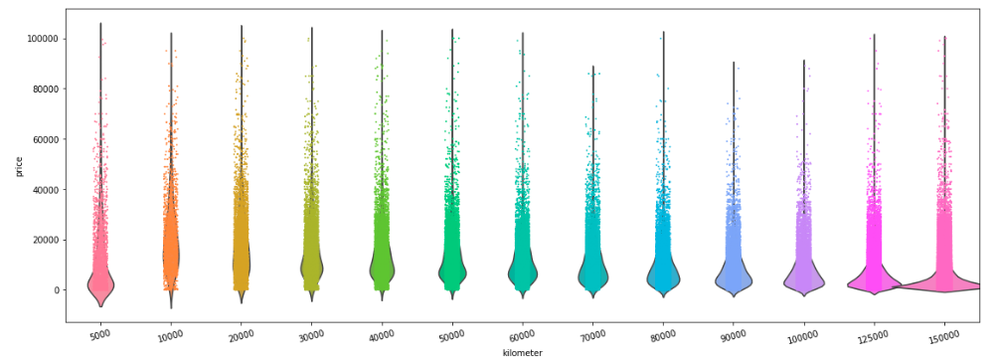
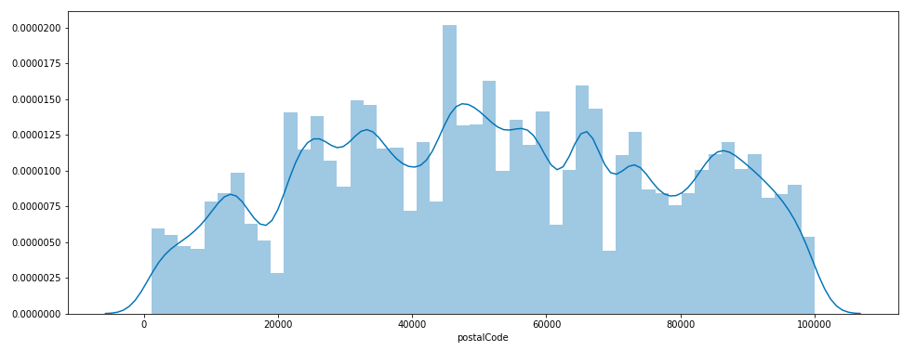
Data Visualization:
The vehicles with a low mileage tend to be the most expensive vehicles as shown on the chart. Some old vehicles with a high value exist. This is most likely due to the condition of the vehicle (classic).
Postal code of '45000' is the town that the highest number of cars are loaded into the website for sale.

Slide 15
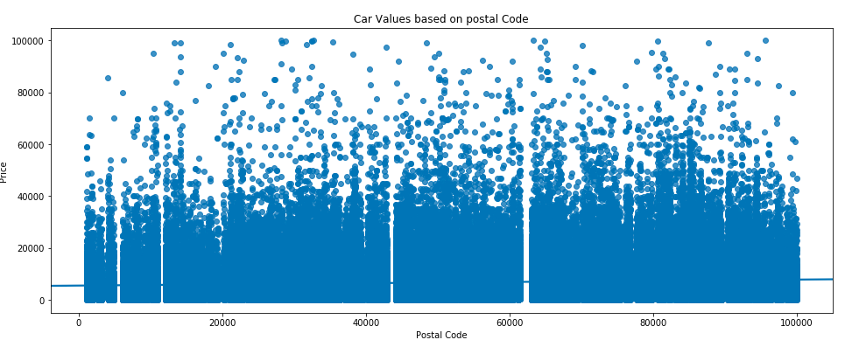
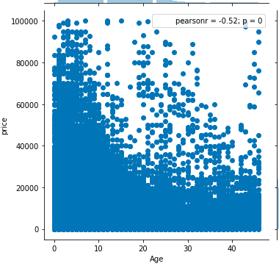
Data Visualization:
A rise on the values of the vehicles loaded from the towns with postel Codes of 80.000 and 85.000 is obvious on the scatter.
It is clear that the vehicles until the age of 10 have the highest values although some old vehicles with a high value exist. It is easy to interpret these vehicles are classic vehicles.

Slide 16
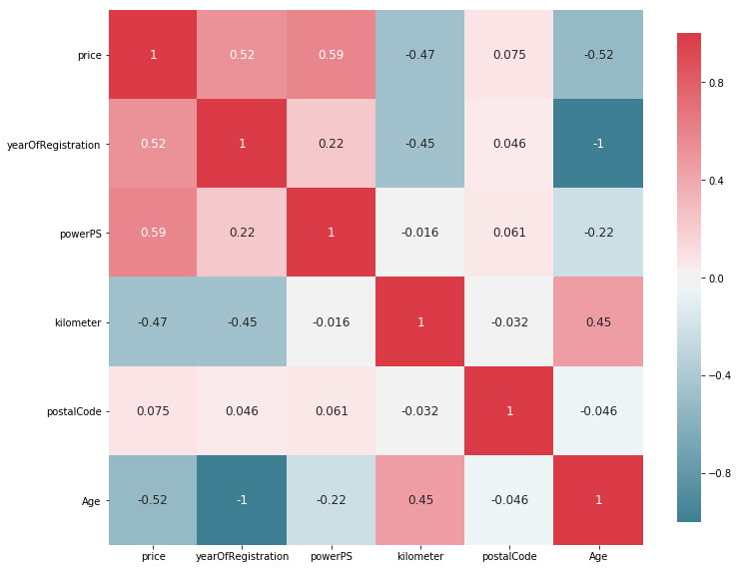
Data Visualization:
From the chart above, we can interpret that ‘yearOfRegistration/Age (same indicator)’ features have a positive correlation of 0.52 with ‘price’ feature. ‘powerPS’ feature which indicates the horsepower of the vehicles have a positive correlation of 0.59 with ‘price’ feature. ‘PostalCode’ has a slight correlation with ‘price’ feature.

Slide 17
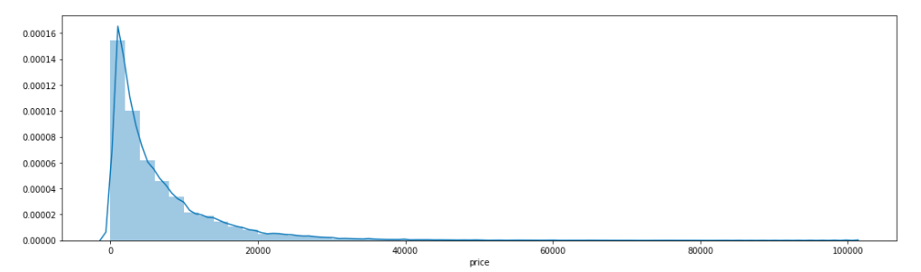
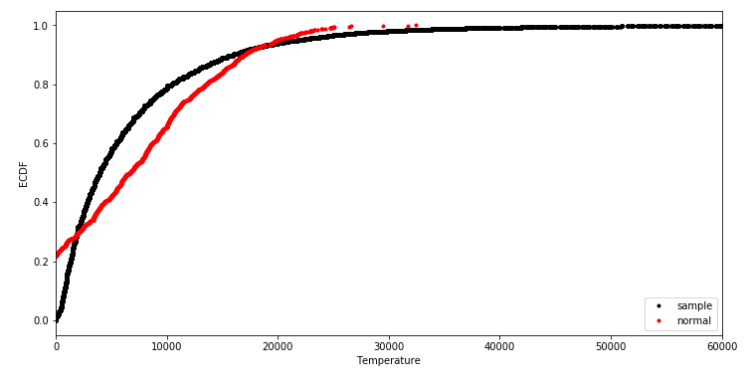
Inferential Statistics:
The values (price) of used vehicles data do not seem to come from a normal distribution. According to the linear regression theorem, it doesn’t have to come from normal distribution taking into consideration that value feature will be the target (y) as long as the residuals (i.i.d) are normally distributed.

Slide 18
Predictive Modeling

Slide 19
Modeling Overview
Type: Supervised learning
Continuous Numerical Value
Tools: Python’s scikit learn and imblearn

Slide 20
Model Assumptions, Limitations and Disclaimers
Assume that all postings are independent
Used the data only from 2016 (Future Work: Should be expanded)
Utilized numerical features first, and then included non-numerical features with get_dummies function
Tried Scaling, though it didn’t improve the model performance.

Slide 21
Regression:
Data preparation and selection
Cross validation for model assessment and selection
Get_dummies of all categorical variables
Randomly select a small subset of the whole data (30%)
5-fold cross validation
At each iteration, perform the data pre-processing and train the classifier using data contained in 4-folds
Evaluate the model using the data contained in remaining one fold
Comparison:
Compared R-Squared and MeanSquared Error all scores

Slide 22
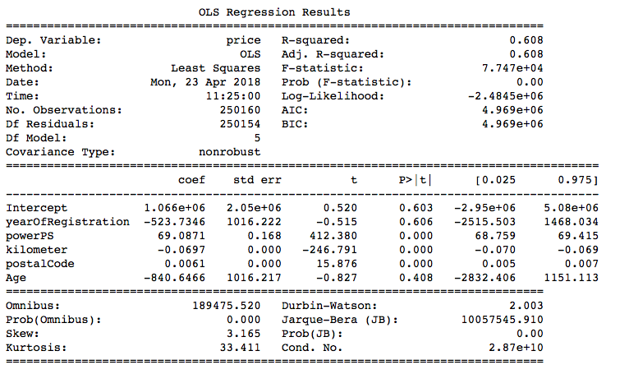
Regression:
The results show a low R-squared of 0.608 which indicates a weak goodness-of-fit. This model also produces a MSE of 25410123.9382. The MSE by itself doesn’t tell how accurate the model is. We will need to calculate the MSE of each of the models to compare which is better.

Slide 23
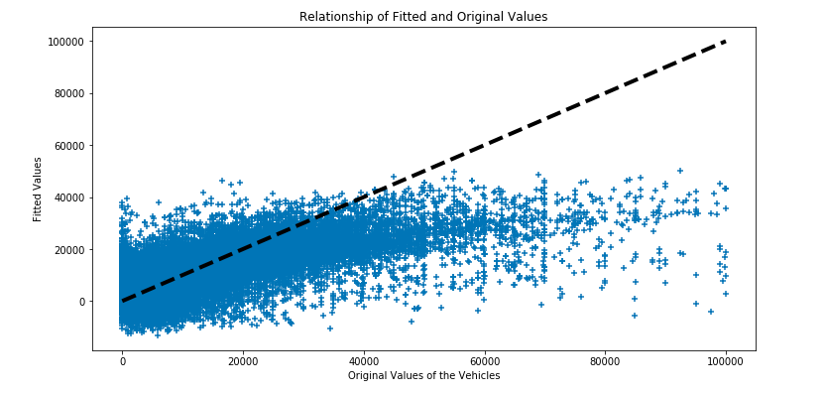
Regression:
It seems that there is no positive linear correlation between fitted values and original prices. Besides this, at most, the model tends to fit the original price poorly. So I will try other models in addition Linear Regression.

Slide 24
Regression:
Model | R-squared | MSE
Linear R | 0.604 | 25410123.9382
Ridge | 0.600 | 25682187.4815
Lasso | 0.604 | 25417144.6858
With only Numeric Features
Model | R-squared | MSE
Linear R | 0.736 | 16922125.1335
Ridge | 0.732 | 17242387.8353
Lasso | 0.73 | 17427420.7108
Including also Non-Numeric Features

Slide 25
Regression:
Model | R-squared | MSE
Random Forest with Numeric | 0.804160991899 | 12592910.4069
Random Forest with all | 0.899070707067 | 6489991.73177

Slide 26
More Ideas to Improve Model in Future
Engineer more features related with Number of Clicks to each Posting, etc.
Extract more data from all year around.
Use other Algorithms/Models to get better results.

Slide 27
Conclusions
All features of dataset contributed to the predictive power of the model
Out of 4 supervised regression models, the Random Forest Regressor provided the best result: R-Squared=0.899 and MSE=
With more ideas, the model can improve in the future

Slide 28
Thank you!
Halil Aksu
Email: halilaksu79@gmail.com
https://www.linkedin.com/in/halilaksu/
https://github.com/codermoder79/

